Slide 1
BlockChain Technology

Slide 2
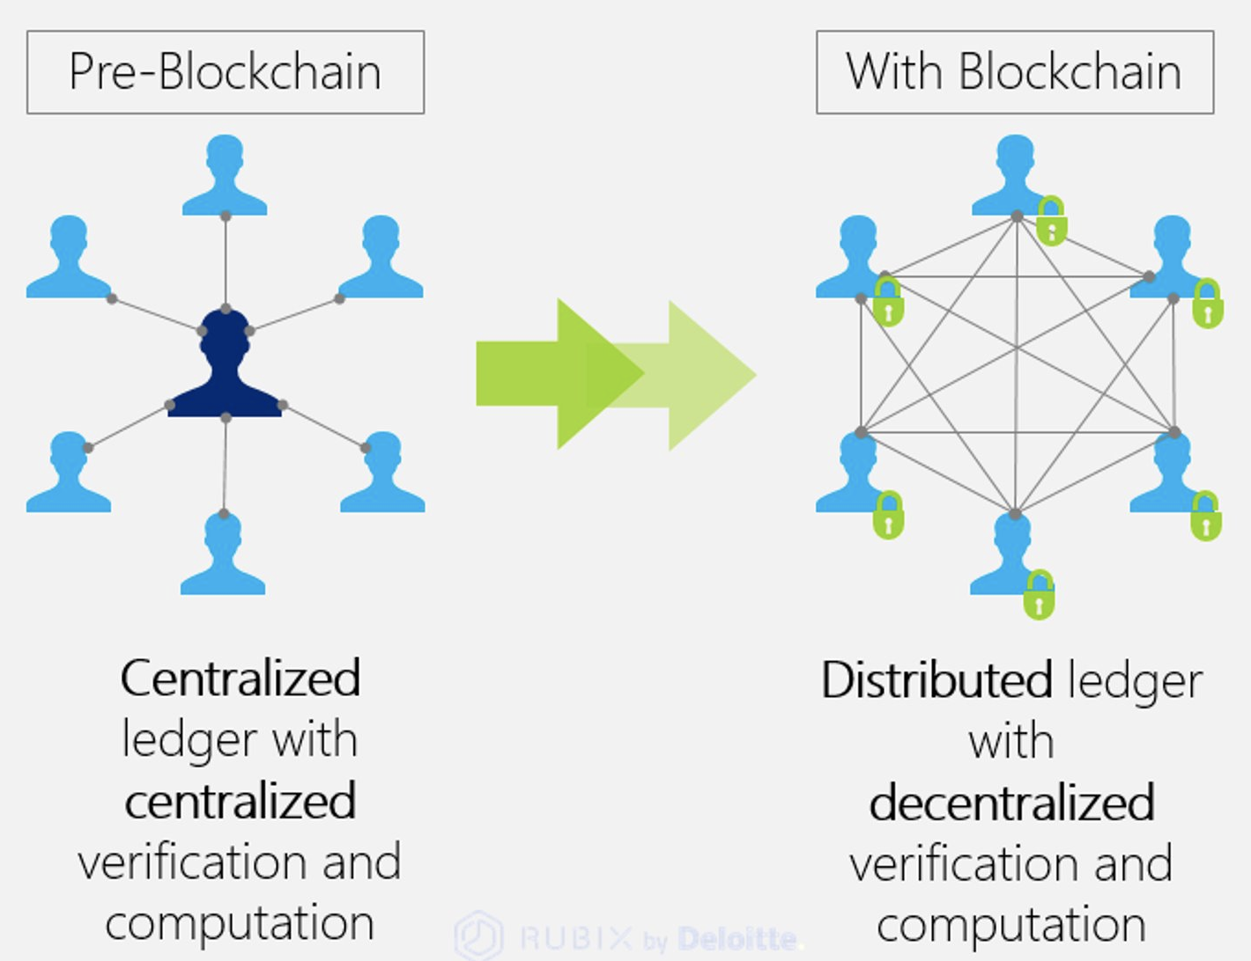
Introduction to Blockchain
Blockchain is a decentralized digital ledger technology that records transactions across multiple computers.
It ensures that records cannot be altered retroactively without the consensus of the network.
This technology underpins cryptocurrencies, but its applications extend far beyond digital currencies.
Notes:
Image source: https://diagramlibpapudocoe.z13.web.core.windows.net/blockchain-diagram-explained.html

Slide 3
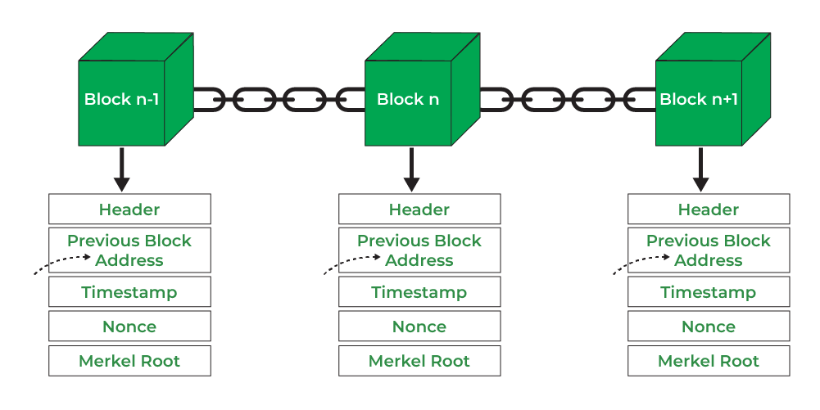
How Blockchain Works
Blockchain operates on a peer-to-peer network, where each participant has access to the entire database.
Transactions are grouped in blocks, which are then chained together through cryptographic hashes.
Each block contains a timestamp and a reference to the previous block, ensuring transparency and security.
Notes:
Image source: https://www.geeksforgeeks.org/blockchain-structure/

Slide 4
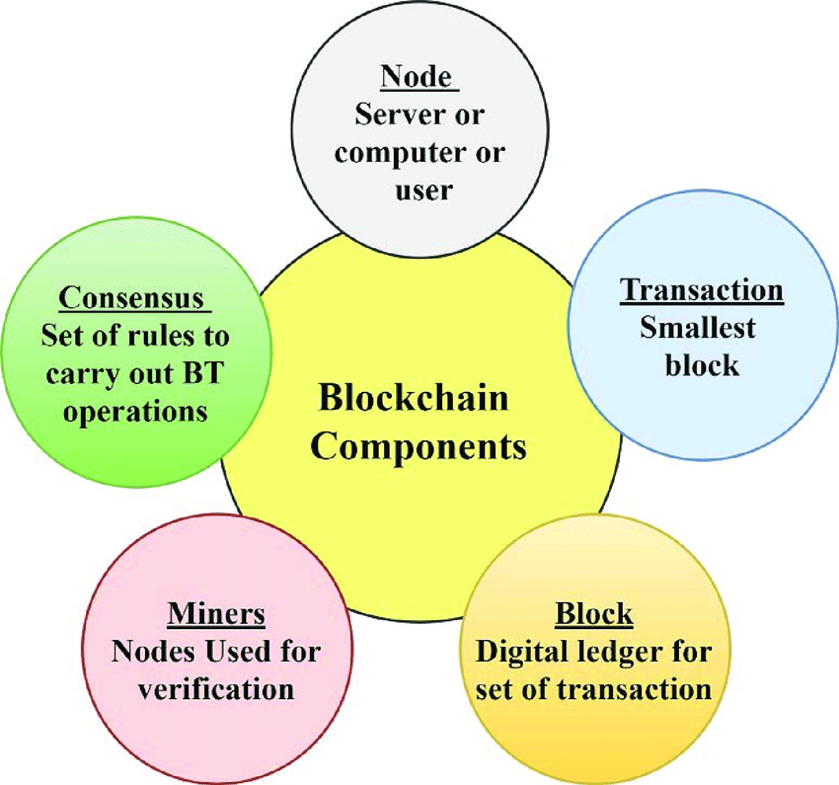
Key Components of Blockchain
Nodes are individual computers that participate in the blockchain network, maintaining a copy of the entire ledger.
Miners validate new transactions and add them to the blockchain by solving complex mathematical problems.
Smart contracts are self-executing contracts with the terms directly written into code, automating processes.
Notes:
Image source: https://www.researchgate.net/figure/Major-components-of-blockchain_fig1_357950461

Slide 5
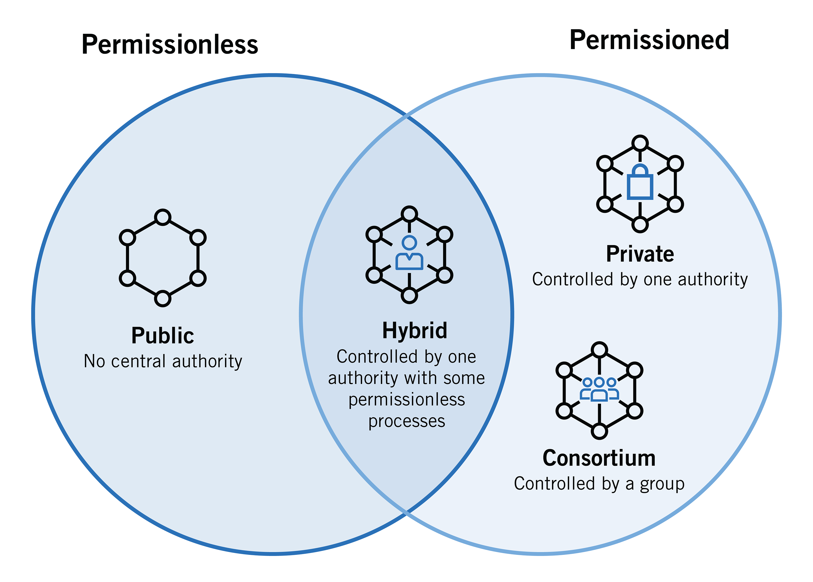
Types of Blockchains
Public blockchains are open to anyone and allow anyone to participate in the network.
Private blockchains restrict access to a select group of participants, often used by businesses.
Consortium blockchains are governed by a group of organizations, balancing decentralization and control.
Notes:
Image source: https://www.jdsupra.com/legalnews/types-of-blockchain-public-private-or-5282575/

Slide 6
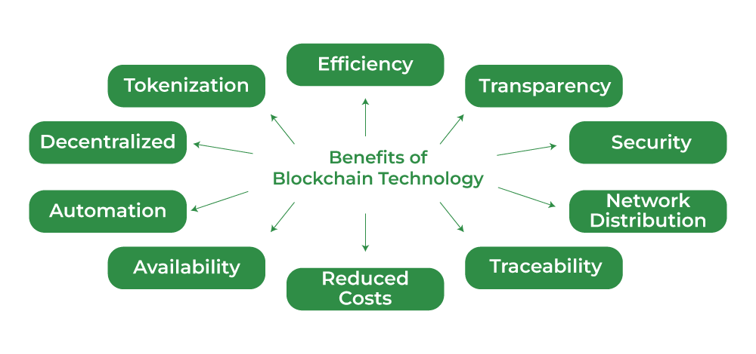
Benefits of Blockchain
Blockchain enhances security through cryptographic techniques, making data tampering nearly impossible.
It promotes transparency since all transactions are recorded and visible to all participants on the network.
The technology reduces costs by eliminating intermediaries and streamlining processes.
Notes:
Image source: https://www.geeksforgeeks.org/benefits-of-blockchain-technology/

Slide 7
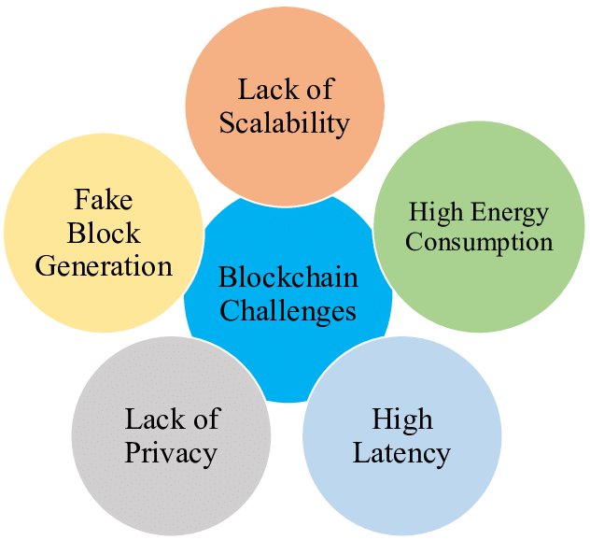
Challenges of Blockchain
Scalability remains a significant challenge, as many blockchains struggle to handle high transaction volumes.
Energy consumption is a concern, particularly with proof-of-work consensus mechanisms used by some cryptocurrencies.
Regulatory uncertainty can hinder adoption, as governments grapple with how to classify and regulate blockchain technology.
Notes:
Image source: http://www.vafion.com/blog/impact-next-gen-block-chains-adoption-iot/

Slide 8
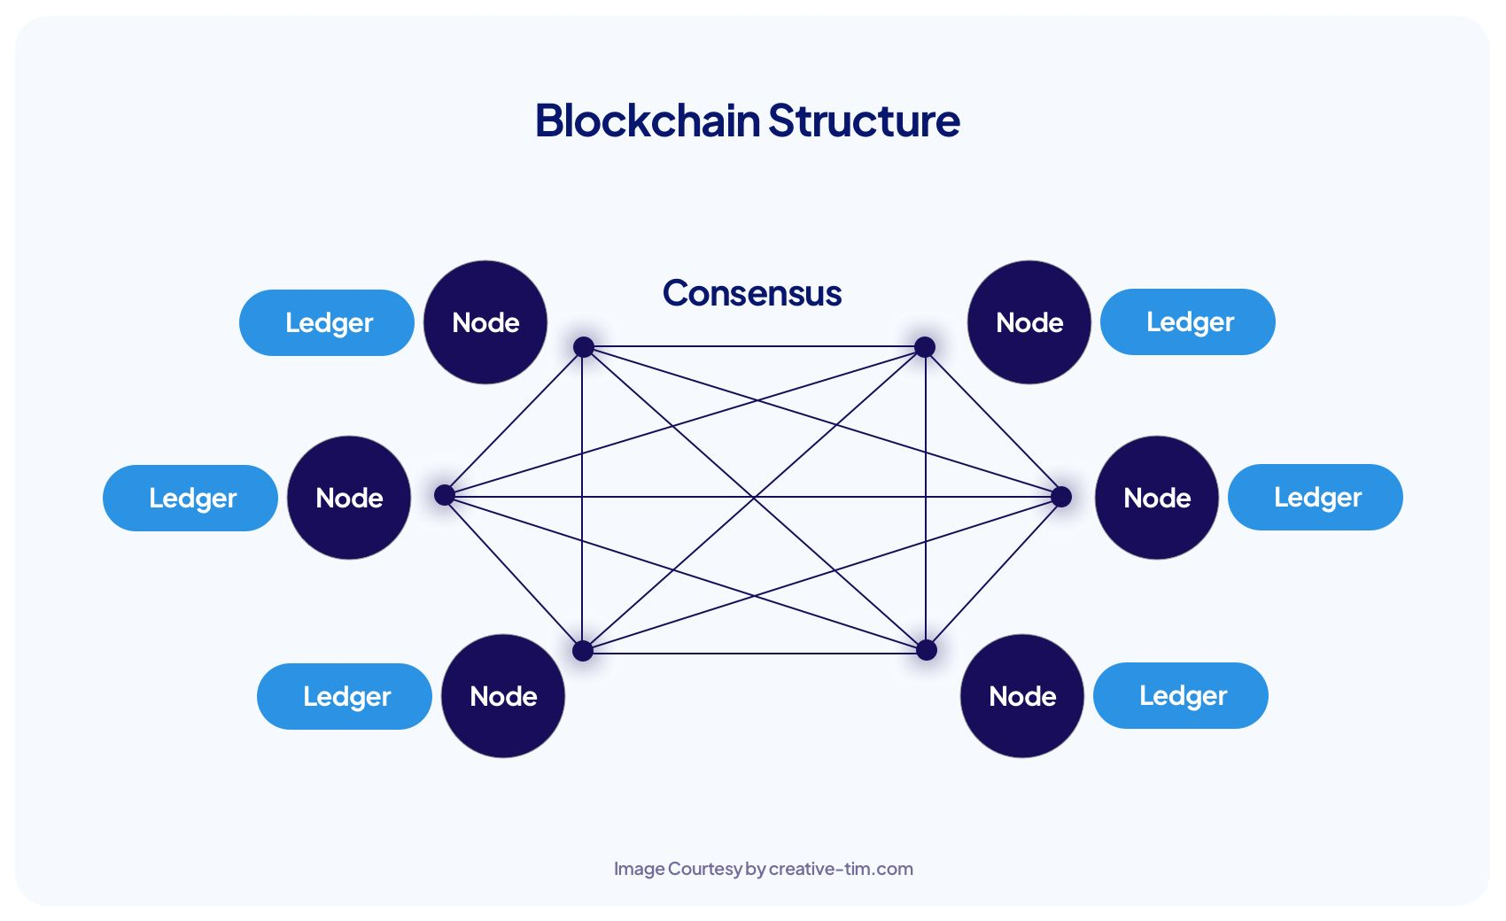
Blockchain in Finance
Blockchain technology has revolutionized the financial industry by enabling faster, cheaper cross-border transactions.
It allows for greater financial inclusion by providing access to banking services for the unbanked population.
Decentralized finance (DeFi) platforms leverage blockchain to offer services like lending and trading without intermediaries.
Notes:
Image source: https://www.creative-tim.com/blog/educational-tech/what-is-blockchain-technology-and-how-does-it-work/?ref=web3-org

Slide 9
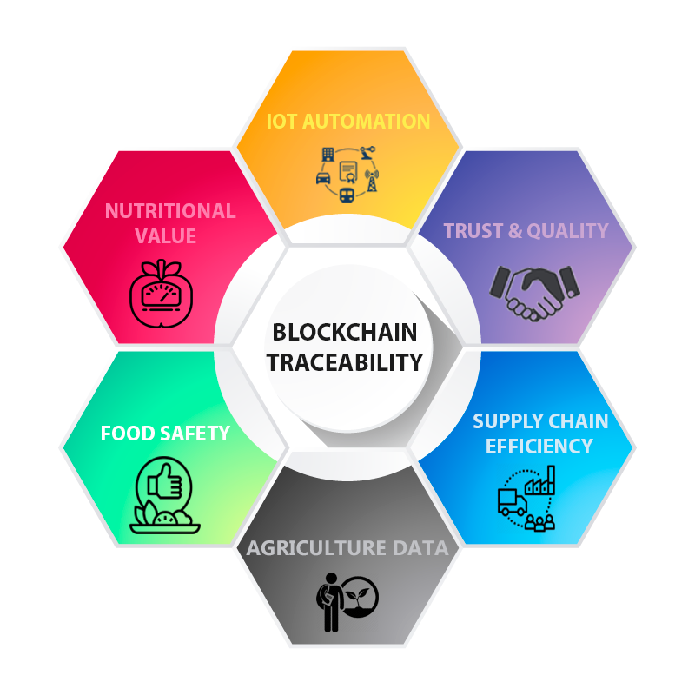
Blockchain in Supply Chain Management
Blockchain enhances traceability in supply chains, allowing for real-time tracking of products from origin to consumer.
It improves accountability by providing a transparent record of every transaction and movement in the supply chain.
Businesses can reduce fraud and errors, ensuring the integrity of their products and processes.
Notes:
Image source: https://www.pinterest.com/pin/678636237578606842/

Slide 10
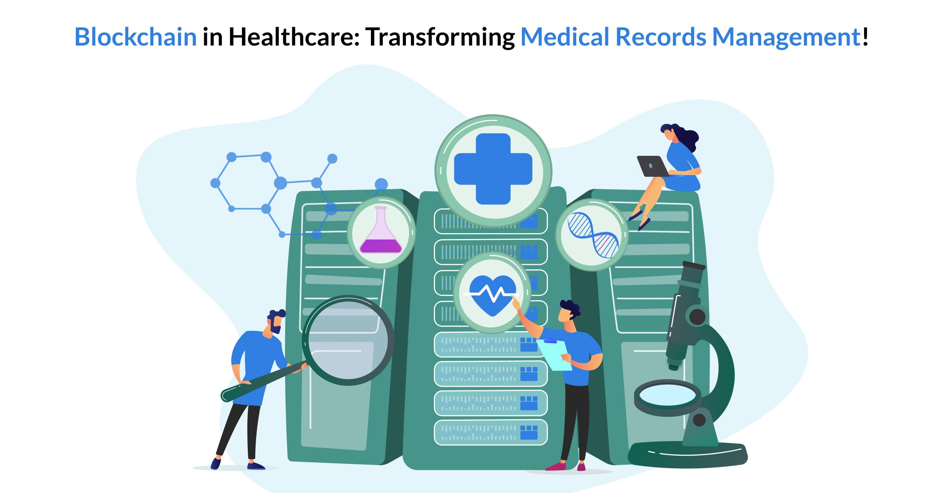
Blockchain in Healthcare
In healthcare, blockchain can securely store patient records, ensuring privacy and data integrity.
It enables interoperability between different systems, allowing for seamless sharing of patient information.
Blockchain can streamline processes like drug supply chain management, reducing counterfeit drugs.
Notes:
Image source: https://remotestate.com/blogs/blockchain-in-healthcare-transforming-medical-records-management

Slide 11
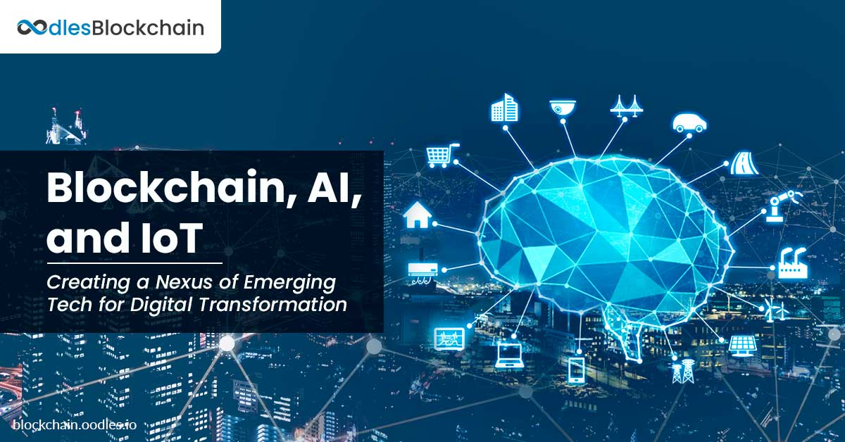
Future Trends in Blockchain
The integration of blockchain with emerging technologies like AI and IoT will create new opportunities and applications.
Layer 2 solutions are being developed to enhance scalability and transaction speed on existing blockchain networks.
Increased focus on sustainability is driving innovation in energy-efficient consensus mechanisms, including proof-of-stake.
Notes:
Image source: https://blockchain.oodles.io/blog/blockchain-ai-iot-business-solutions/

Slide 12
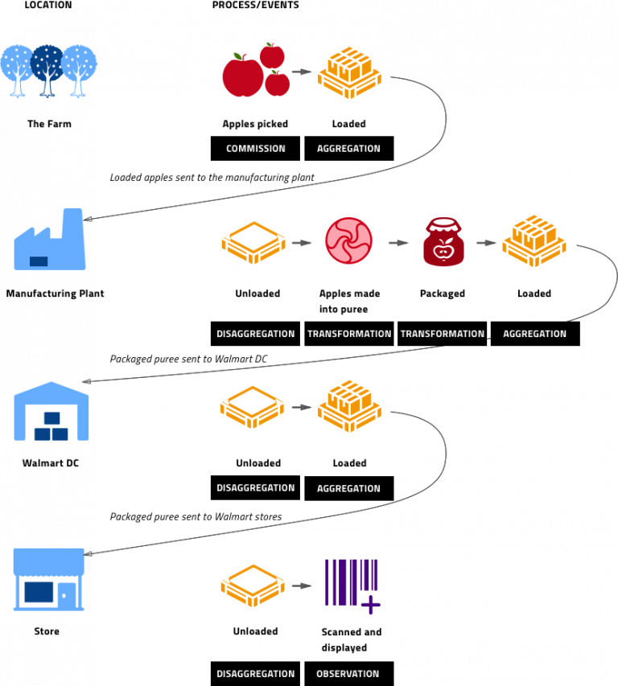
Case Studies of Blockchain Applications
Companies like IBM and Walmart are using blockchain to enhance transparency and efficiency in food supply chains.
Ethereum has pioneered the use of smart contracts, enabling decentralized applications (dApps) across various industries.
Governments are exploring blockchain for secure voting systems and digital identity verification.
Notes:
Image source: https://byteally.com/insights/supply-chain/integrating-with-ibm-food-trust-blockchain-guide/

Slide 13
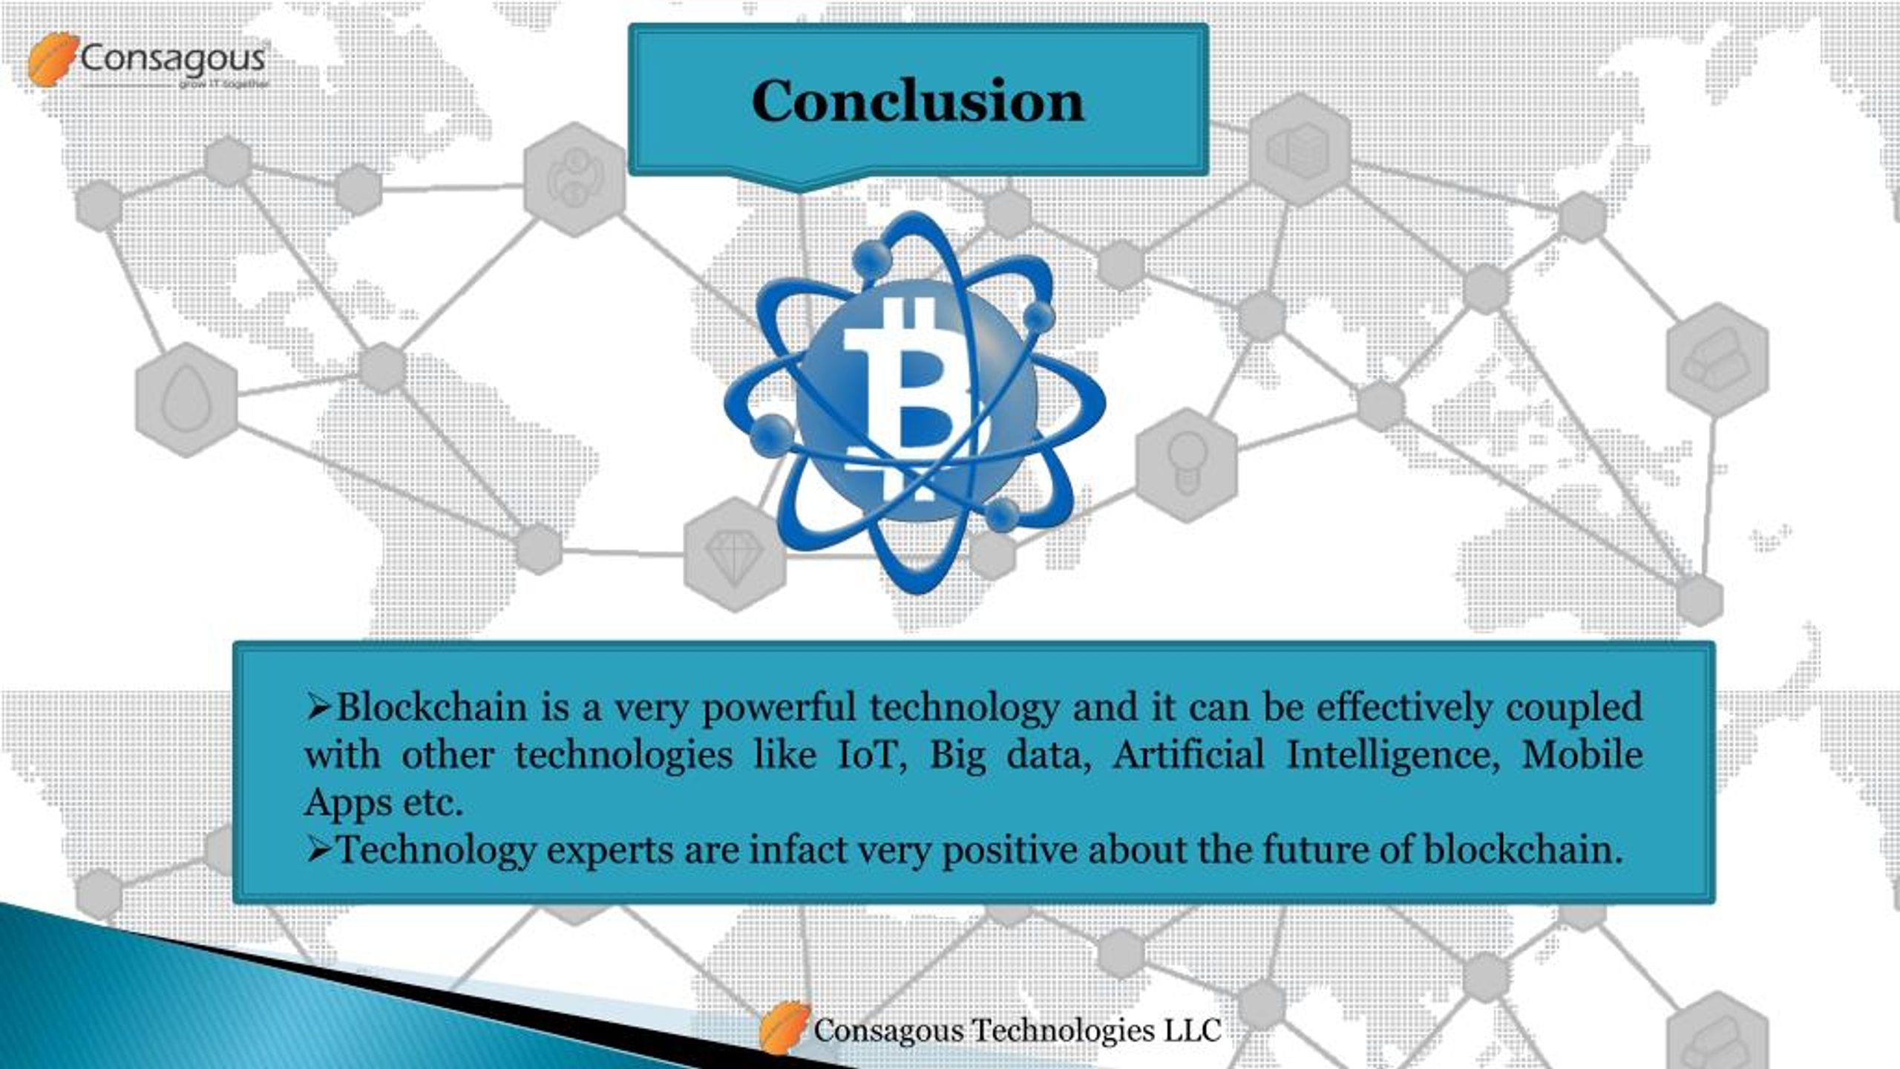
Conclusion
Blockchain technology has the potential to transform multiple industries by increasing efficiency and transparency.
While challenges remain, ongoing innovation is paving the way for broader adoption and new use cases.
As understanding of blockchain grows, its impact on society and the economy will continue to evolve.
Feel free to customize any part of the presentation to better suit your needs!
Notes:
Image source: https://www.slideserve.com/consagousmridul/8-steps-to-develop-a-successful-blockchain-mobile-app

